Slide 1
Environmental Risk Management
A pressing issue for energy companies
BP oil spill: entering a new era
Risk management: compliance is not enough
Theoretical frame work: Risk exposure and value
Lessons from BP

Slide 2
Risk Management: a concern in the energy sector
BP oil spill: before…and after
“Neither the industry’s nor the federal government’s approaches to managing and overseeing the leasing and development of offshore resources have kept pace with rapid changes in the technology, practices and risk associated with the different geological and ocean environments being explored and developed for oil and gas production »
Presidential Commission’s report after the golf of Mexico spill.
(British) Oil and Gas Industry warned about Safety Record
Posted on September 28, 2010 by crsadmin
The British offshore oil and gas industry has been warned about its safety record as new statistics show an increase in major injuries and hydrocarbon releases
Oil and gas spills in North Sea every week, papers reveal
Documents list companies that caused more than 100 potentially lethal – and largely unpublicised – leaks in 2009 and 2010
Rob Evans, Richard Cookson and Terry Macalister ; guardian.co.uk, Tuesday 5 July 2011

Slide 3
Related issues
Valuing “contingent environmental liability”
Energy companies are exposed to the risk of severe potential losses due to cleanup costs and compensations to be paid to the many victims – all the more if liability caps are removed - These “high impact low probability events” may indeed affect seriously the financial structure of companies. Yet it is not clearly reflected in their balance sheet. Should it be? And, if yes, how?
Environmental liability: an issue for lawyers...and insurers
In the past, insurers have contributed to the emergence of new technologies and economic development by providing economic agents not only with indispensable financial guaranties in case of adverse events but also by promoting prevention and safe behaviours. With no doubt, they will have a say in this debate: what are the limits of insurability? How to deal with “moral hazard”? how to price environmental risks? Lawyers will have to cooperate with insurers before they decide on principles for dealing with environmental disasters .
Public-Private joint Energy developments: governments should also be prepared to the risk...not just revenues
Most of energy projects are developed in order to enhance economic growth and provide nations with a reasonable level of energy security and/or take advantage of local energy resources. This explains the high degree of involvement of public authorities in energy projects developed and operated by private entities. Are public authorities taking the full measure of the environmental risks involved? Are they prepared to take charge of their own share of the responsibility and to deploy appropriate means to limit the severity of the catastrophe if needed? Recent examples seem to indicate that this is not the case.
Environmental risk: an urgent need for new safety regulations and standards in the energy industry
Considering the serious threat to the environment due to the introduction of “frontier technologies” in difficult conditions, there is an urgent need for well designed safety regulations, setting standards on a “case by case” basis, with a coordinated approach. Due to the large geographical scope of major risks, there is also an obvious need for international, or at least regional, cooperation. What is the situation today? Who should be in charge?

Slide 4
Effective Risk Management
Three levels to consider
EXTERNAL CONSTRAINTS & GOVERNANCE
Investors & Financial Market Authorities
Financial security rules
Community at large (CSR), public agencies
HSE standards and rules
COMPLIANCE
Risk mitigation
(procedures, safety equipments, risk transfer)
Communication, training..
HSE Policy
Risk
Identification
& measurement
Risk control system
Reporting
BEHAVIOURS
Motivation, incentives, sanctions
The weak link
Effective Risk Management

Slide 5
Investors do not seem to care so much!
Companies must deliver what investors expect (Need for transparency, Free Cash Flow and required rate of return, risk exposure in line with risk appetite) ... But risk is less tangible than profitability!
Default risk is seen as low considering the high value and liquidity of oil & gas assets (after all BP is still alive!)
“Accidental risks” can be diversified away since they are not “correlated”. Therefore spending to reduce this type of risks should be limited (diversification as a free insurance)
.....Except if investors value sustainability (SRI funds)

Slide 6
Organisations out of control allowing excessive risk taking
Need for delegation for quick decisions in a competitive environment also requires sophisticated control systems in large and complex organisations (“bureaucratisation” of Risk Management)
Technological complexity is a source of information asymmetry which limits the reliability of controls and favours “moral hazard”
Systematic outsourcing further reduces the capability of operators to control how activities are run along the value chain
Paying the price of human resource flexibility: individualism and short–termism may result in excessive risk taking
Performance indicators still mostly place the emphasis on cash-flow generation and profitability

Slide 7
RISK EXPOSURE
Economic Balance Sheet
(+)
Insurance,
revenue and risk sharing agreements with other stakeholders allowing an external contribution to pay claims
Contingent assets
Contractual guarantees
Contingent liabilities
Liability risk
(-)
(+)
(+)
Financial debt
reputation loss weakening bargaining power and increasing uncertainty for future business, human capital loss, Business interruption loss
Intangible assets
capacity to generate future cash-flows
Equity
Destruction of fixed assets
Tangible assets

Slide 8
Why Risk Management matters

Slide 9
BP share price evolution compared to the industry
Following the oil spill BP share price has dropped dramatically - and comparable companies also though to a lesser extent - Then the company did not fully benefit from the industry momentum

Slide 10
- 42.5%
It took about 50 days for BP share price to reach a new level. Considering the evolution of comparables BP share price appears to be 42.5% lower than it would have been with no accident.
Estimated equity loss: 50 billions £
About 80 billions us$
This amount is significantly higher than the estimated oil spill liability and cleaning cost (of about 40 billions $), the market seems to have also priced the reputation loss

Slide 11
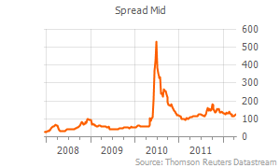
BP Default Risk Market Assessment
CDS 10 years maturity
About BBB
BP explains how estimated losses (40 Billions $)can be financed to come back to an acceptable debt ratio
Though the anticipated outflows due to the oil spill are very high, the market remains rather confident in the capacity of BP to find enough resources because of the high level of liquidity of its upstream assets and its cash flow generation capacity
However, it would have been a serious issue for a smaller company and it may worsen if liability caps are removed

Slide 12
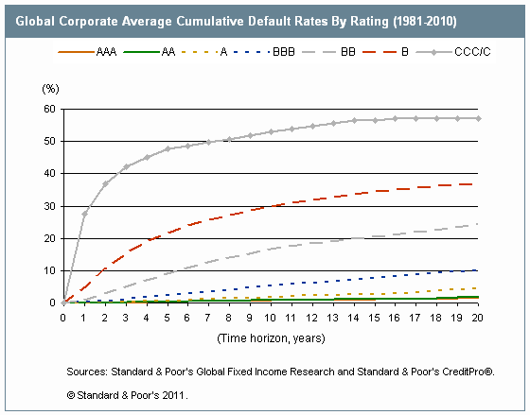
Default probability
BB
BBB
Even at the peak of the crisis, the assessed probability of default remains rather low

Slide 13
Industry Default Risk assessment after BP oil spill
BP oil spill did influence the market perception of default risk for comparables
After about 50 days it came back to normal, except for TOTAL
May be size matters!

