Slide 1
The Oil Majors and the US Geo-Strategy in Eurasia after the End of Cold War
Anthony Livanios
CEO
Energy Stream CMG GmbH
January 21, 2014

Slide 2
The US Oil Industry in American Business Culture

Slide 3
The US Oil Industry in American Business Culture

Slide 4
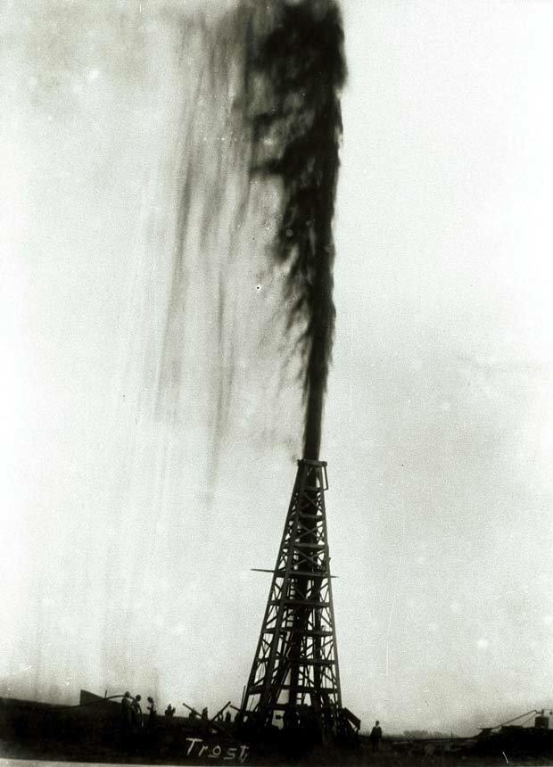
The US Oil Industry
Spindletop, Texas
January 10, 1901
80.000 bbl/day
Turning point in the history of Texas and the United States
Texas Oil Boom – US became the world‘s largest oil producer

Slide 5
The US Oil Industry at the End of Cold War Daniel Yiergin

Slide 6
The US Geostrategy at the End of Cold War in Eurasia Zbigniew Brzezinski

Slide 7
The US Oil Industry, the US Government and the Power of EXXONMOBIL

Slide 8
The US Oil Industry and the Future of Shale Gas and Tight Oil

Slide 9
The US Oil Industry: A Critical Approach

Slide 10
The US Oil Industry in the New Great Game in Eurasia

Slide 11
The US Geostrategy in Eurasia and Russian Oil Industry

Slide 12
The Geopolitical Rivalry in the New Great Game in Eurasia and Russian Oil Industry

Slide 13
The US Geostrategy and the challenge of the Iranian Oil Industry

Slide 14
The Geopolitical Rivalry in the New Great Game in Eurasia

Slide 15
The Oil and Gas Pipeline competition in Eurasia

Slide 16
The Economics of Oil and Gas in the Caspian

Slide 17
The US Geostrategy at the End of Cold War: The Caspian Sea and the Persian Gulf Oil Fields

Slide 18
The US Geostrategy at the End of Cold War: The Persian Gulf Oil Fields

Slide 19
The US Geostrategy at the End of Cold War: The Persian Gulf Proven Oil Reserves
The Persian Gulf produced about 28 percent of the world's oil supply and exported over 18 million bbl/d in 2006. In 2006, the Persian Gulf countries produced about 28 percent of the world's oil, while holding 55 percent (728 billion barrels) of the world's crude oil reserves. In 2006, the Persian Gulf countries combined exported 18.2 million barrels per day (bbl/d) including about 17 million bbl/d via the Straight of Hormuz representing roughly one-fifth of world oil supply.
Source: United States Energy Information Administration, 2007

Slide 20
The US Geostrategy at the End of Cold War: The Caspian Sea Oil Fields

Slide 21
The US Geostrategy at the End of Cold War: The Caspian Sea Proven Oil Reserves
EIA estimates 48 billion barrels of oil and 292 trillion cubic feet of natural gas in proved and probable reserves in the Caspian basins. Almost 75 percent of oil and 67 percent of natural gas reserves are located within 100 miles of the coast.
Source: United States Energy Information Administration, August 26, 2013

Slide 22
Eurasia and Caspian Sea: The New Frontier of Oil and Gas
My research question:
What is the geo-strategy of the United States and what is the role of the U.S. oil majors in the new Great Game of oil and gas in Eurasia after the Cold War?

Slide 23
Eurasia and Caspian Sea: The New Frontier of Oil and Gas
My research is focusing on the five Caspian Littoral states:
Kazakhstan
Azerbaijan
Turkmenistan
Russia
Iran

Slide 24
Eurasia and Caspian Sea: The New Frontier of Oil and Gas
Qualitative research based on:
In-depth interviews
Empirical answers
Senior oil executives from US oil majors and National Oil Companies
US and Eurasian Government officials
US and Eurasian Oil and Gas experts

Slide 25
What is the challenge for the US Oil majors in the Caspian Sea?
In the Caspian Landlocked Region the ownership and control of the Pipelines is key for the production and trading of oil and natural gas: Oil and Gas Pipelines are Strategic Assets

Slide 26
The Challenge of the US Oil Industry in the 1990s, the M&As between 1998-2002, and the New Oil Majors

Slide 27
Kazakhstan, Chevron, Tengizchevroil and the the Caspian Oil Pipeline Consortium: the 1990s

Slide 28
Kazakhstan, Chevron, Tengizchevroil and the the Caspian Oil Pipeline Consortium: the 1990s

Slide 29
Kazakhstan and the Caspian Oil Pipeline Consortium: the 1990s

Slide 30
Azerbaijan and the US Geostrategy: the 1990s Zbigniew Brzezinski

Slide 31
Azerbaijan Oil and Gas Infrastructure Today

Slide 32
Azerbaijan and the US Geostrategy: The Baku Tbilisi Ceyhan Oil Pipeline: the 1990s

Slide 33
Azerbaijan and the US Geostrategy: The Baku Supsa Oil Pipeline: the 1990s

Slide 34
Azerbaijan, the US Geostrategy and the competing pipelines of the Southern Gas Corridor: the late 1990s and the decade 2000s

Slide 35
Azerbaijan, the US Geostrategy, and the Southern Gas Corridor
Diversify the routes and resources for European gas supplies
Europe: less depenedent on Russian gas
Caspian Gas to Europe: more gas supplies to the international markets
Strengthen the EU energy security

Slide 36
Azerbaijan, the US Geostrategy and the Winner Pipeline of the the Southern Gas Corridor: December 2013

Slide 37
Azerbaijan, the US Geostrategy, Turkey and the Trans Anatolian Pipeline

Slide 38
Azerbaijan, the US Geostrategy, Greece, and the Trans Adriatic Pipeline

Slide 39
Turkmenistan, the US Geostrategy and the Trans Caspian Pipeline: Geopolitical challenge

Slide 40
Turkmenistan, the US Geostrategy and the Trans Caspian Pipeline: Geopolitical challenge

Slide 41
Russia: Challenges the United States Geostrategy via South Stream

Slide 42
Russia: Challenges the United States Geostrategy in Eurasia

Slide 43
Russian Geostrategy on Gas Pipelines Challenges the United States Geostrategy in Eurasia

Slide 44
Iran Oil and Gas Fields

Slide 45
Iran Natural Gas Fields

Slide 46
US Geostrategy and US Sanctions on Iran Natural Gas Pipelines

Slide 47
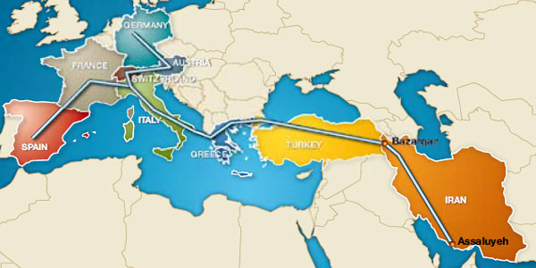
Iran: Geopolitical Challenge to the US Geostrategy on the Southern Gas Corridor

Slide 48
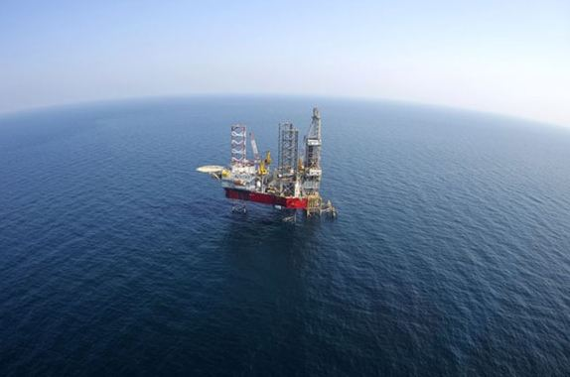
Thank you

